Slide 1
MODULE-2
Module-2: Test Case Development and Execution (16 Hrs)
Test Cases: Identification of Test case Scenarios
Test Case Template
Writing Test cases for Problems
Test Case Execution
Examples for Lab Exercises.

Slide 2
BOUNDARY VALUE ANALYSIS (BVA) TESTING
Boundary value testing is focused on the values at boundaries. This technique determines whether a certain range of values are acceptable by the system or not.
It is very useful in reducing the number of test cases. It is most suitable for the systems where an input is within certain ranges.
Boundary value analysis (BVA) is based on testing the boundary values of valid and invalid partitions.
The Behavior at the edge of each equivalence partition is more likely to be incorrect than the behavior within the partition, so boundaries are an area where testing is likely to yield defects.

Slide 3
The basic assumption of boundary value analysis is, the test cases that are created using boundary values are most likely to cause an error.
There is 18 and 30 are the boundary values that's why tester pays more attention to these values, but this doesn't mean that the middle values like 19, 20, 21….27,28, 29 are ignored. Test cases are developed for each and every value of the range.

Slide 4
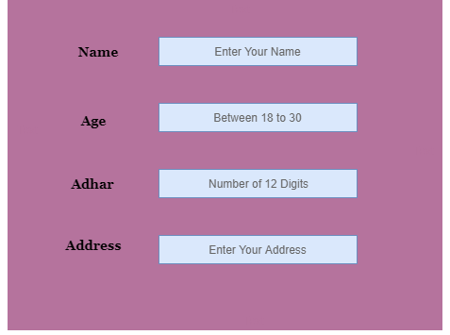

Slide 5
Boundary Value Testing
Any program can be considered to be a function in the sense that prog. I/p form its domain & prog. o/p form its range.
Input domain testing is the best known functional testing technique.

Slide 6
Boundary Value Analysis
When function F is implemented as a pogram, the input variables x1 & x2 will have some boundaries
F(x₁, x₂), a ≤ x₁ ≤ b, c ≤ x₂ ≤ d
[a,b] [c,d] are ranges of x1 & x2.

Slide 7
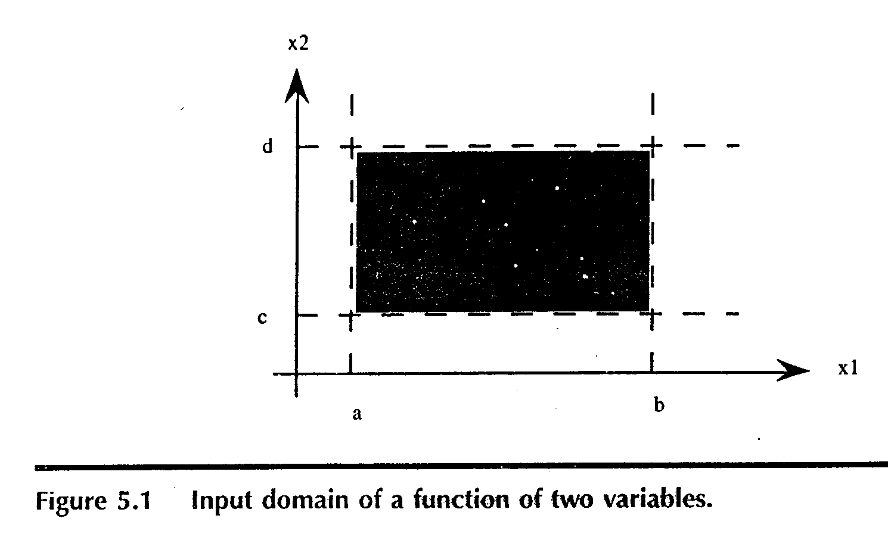
Input space(domain) of our function F is shown above.
Any point within the shaded rectangle is a legitimate input to the
function F.
Boundary value analysis focuses on the boundary of the input space to identify test cases.

Slide 8
Cont.,
Errors tend to occur near the extreme values of an input variable
e.g. loop conditions (< instead of ≤), counters
Basic idea: use input variable values at their minimum (min), just above the minimum (min+), a nominal value (nom), just below their maximum (max-), and at their maximum (max).
Testing tool (T) generates such Test Cases for Properly specified program. min, min+, max-, max.

Slide 9
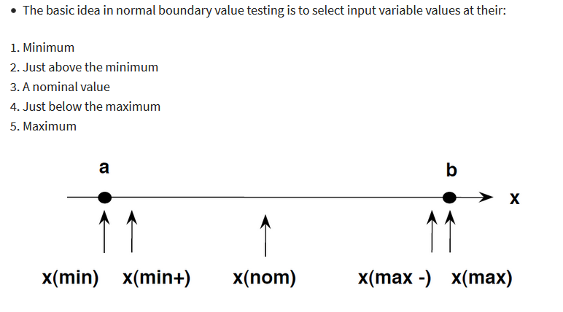

Slide 10
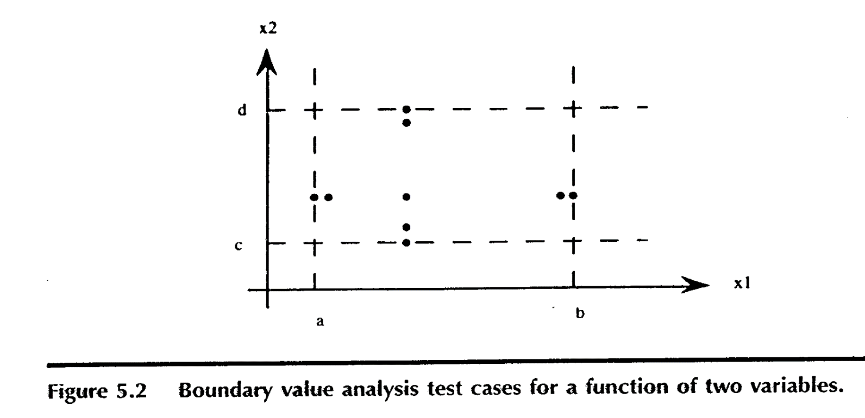
Cont.,
The boundary value analysis test cases are obtained by holding the values of all but one variable at their nominal values, and letting that variable assume its extreme values

Slide 11
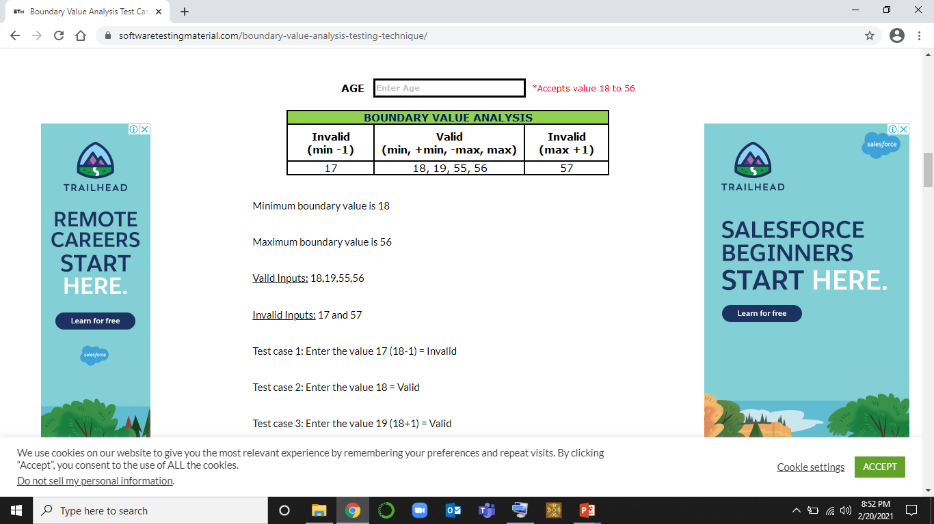
1) Example on Boundary Value Analysis Test Case Design Technique: Assume, we have to test a field which accepts Age 18 – 56

Slide 12
Test case 4: Enter the value 55 (56-1) = Valid
Test case 5: Enter the value 56 = Valid
Test case 6: Enter the value 57 (56+1) =Invalid

Slide 13
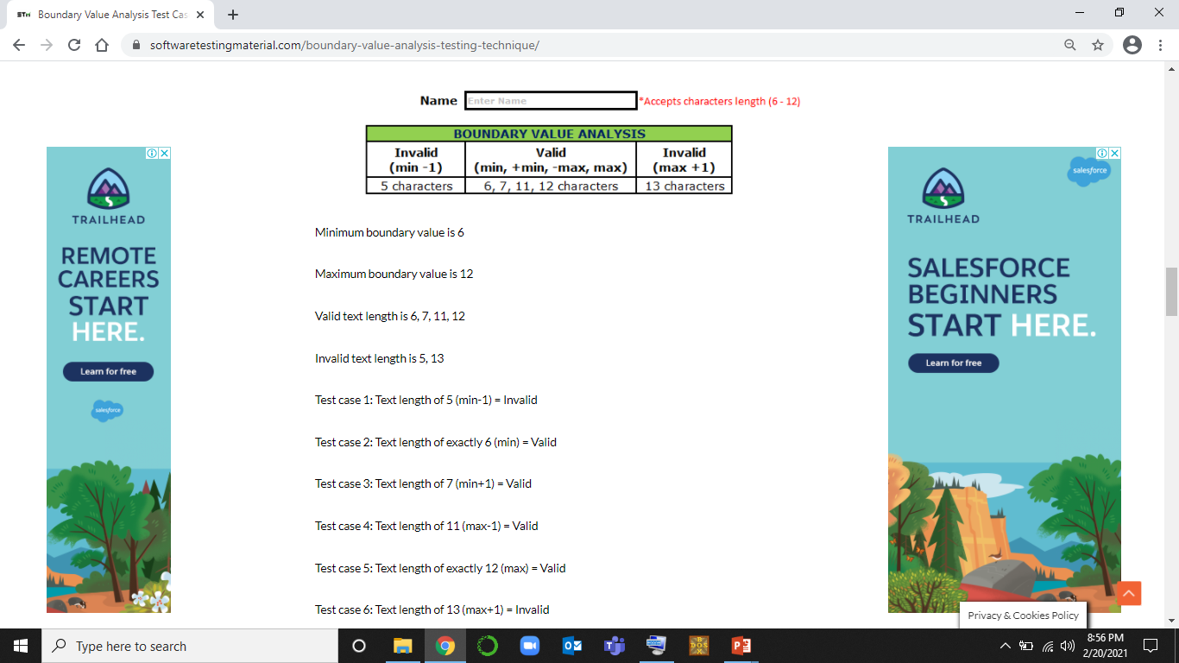
Example 2: Assume we have to test a text field (Name) which accepts the length between 6-12 characters.

Slide 14
EXAMPLE 3 Design boundary value test cases for a Pizza delivery app. Pizza values 1 to 10 is considered valid. A ORDER SUCCESS message is shown. While value 11 to 99 are considered invalid for order and an ERROR message will appear, "Only 10 Pizza can be ordered"
Minimum boundary value is 1
Maximum boundary value is 10
Valid Inputs: 1,2,9,10
Invalid Inputs: 0 ,11
Test case 1: Entered value on App 0 (min-1) = Invalid ERROR
Test case 2: Entered value on App 1 (min) = Valid ORDER SUCCESS
Test case 3: Entered value on App 2 (min+1) = Valid ORDER SUCCESS
Test case 4: Entered value on App 9 (max-1) = Valid ORDER SUCCESS
Test case 5: Entered value on App 10 (max) = Valid ORDER SUCCESS
Test case 6: Entered value on App 11 (max+1) = Invalid ERROR

Slide 15
EQUIVALENCE PARTITIONING TESTING METHOD
Equivalence Partitioning Method is also known as Equivalence class partitioning (ECP). It is a software testing technique or black-box testing that divides input domain into classes of data, and with the help of these classes of data, test cases can be derived.
An ideal test case identifies class of error that might require many arbitrary test cases to be executed before general error is observed.
In equivalence portioning, equivalence classes are evaluated for given input conditions. Whenever any input is given, then type of input condition is checked, then for this input conditions, Equivalence class represents or describes set of valid or invalid states.

Slide 16
Contents
Equivalence class.
Weak normal equivalence class testing.
Strong normal equivalence class testing.
Weak Robust equivalence class testing.
Strong Robust equivalence class testing.

Slide 17
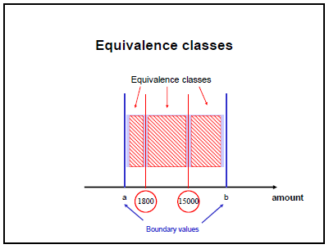
Equivalence class Testing
– amount <= 1800
– 1800 < amount < 15000
– amount >= 15000

Slide 18
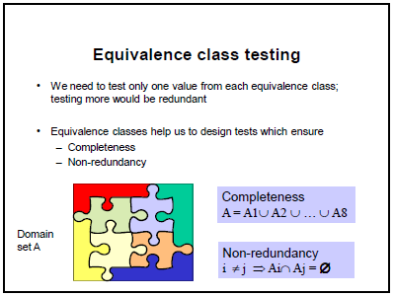

Slide 19
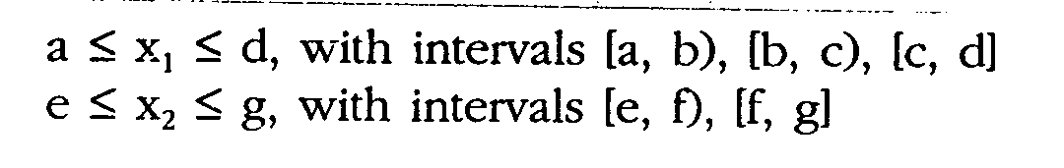
Equivalence class Testing
When Function F is implemented as a program, the input variables x1,x2 will have boundaries

Slide 20
Weak Normal Equivalence class Testing
Assumes the ‘single fault’ or “independence of input variables.”
e.g. If there are 2 input variables, these input variables are independent of each other.
Partition the test cases of each input variable separately into one of the different equivalent classes.
Choose the test case from each of the equivalence classes for each input variable independently of the other input variable
Using 1 variable from each equivalence class(interval) in a test case.

Slide 21
Weak Normal Equivalence class test cases
X2
g
f
e
x1
a
b
c
d

Slide 22
Strong Normal Equivalence testing
Multi Fault assumption.
We need Test cases from each element of the Cartesian product of the equivalence classes.
The Cartesian product guarantees that we have a notion of completeness in two senses
We cover all the equivalence classes,
We have 1 of each possible combination of inputs.

Slide 23
Strong Normal Equivalence class test cases
X2
g
f
e
x1
a
b
c
d

Slide 24
Weak Robust Equivalence class Testing
Up to now we have only considered partitioning the valid input space.
“Weak robust” is similar to “weak normal” equivalence test except that the invalid input variables are now considered.
The robust part comes from consideration of invalid values, & the weak part refers to the single fault assumption.

Slide 25
Strong Robust Equivalence Testing
Robust part comes from consideration of invalid values,
Strong part refers to the multiple fault assumption.
We obtain test cases from each element of the Cartesian product of all the equivalence classes

Slide 26
Strong robust Equivalence class test cases
X2
g
f
e
x1
a
b
c
d

Slide 27
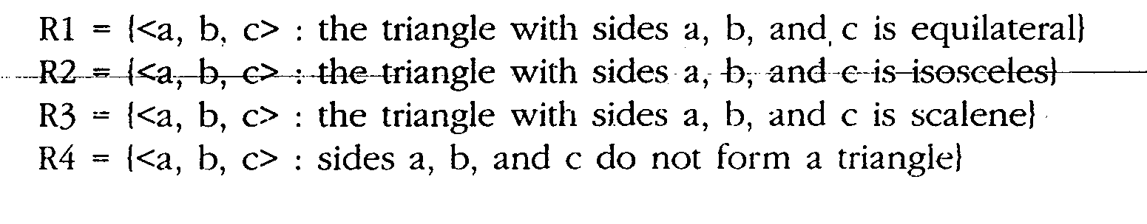
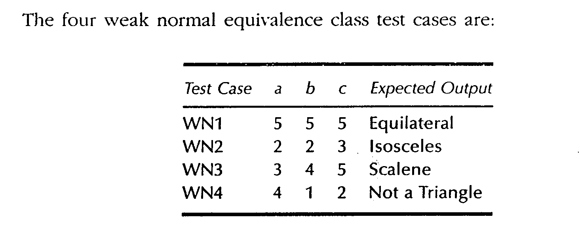
Equivalence class Test Cases for Triangle problem

Slide 28
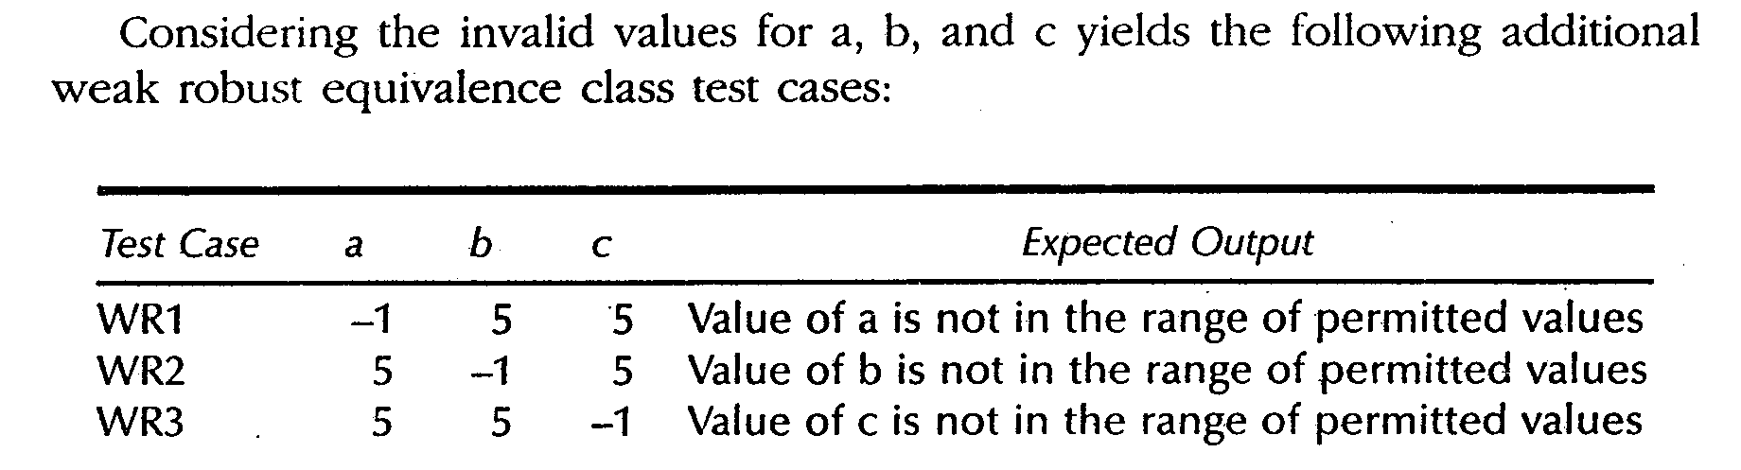
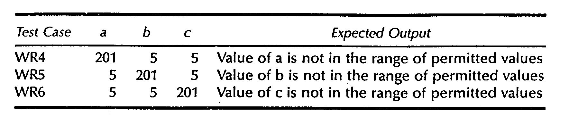

Slide 29
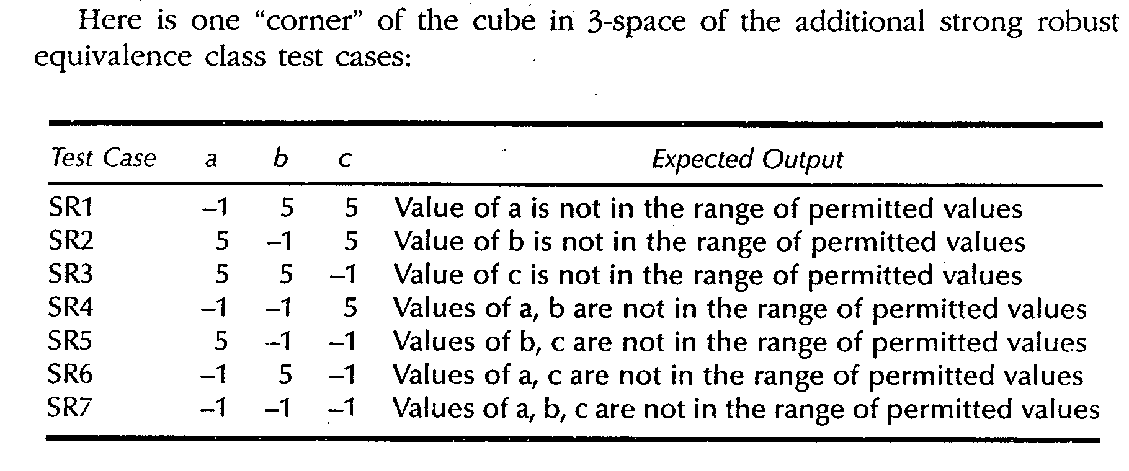

Slide 30
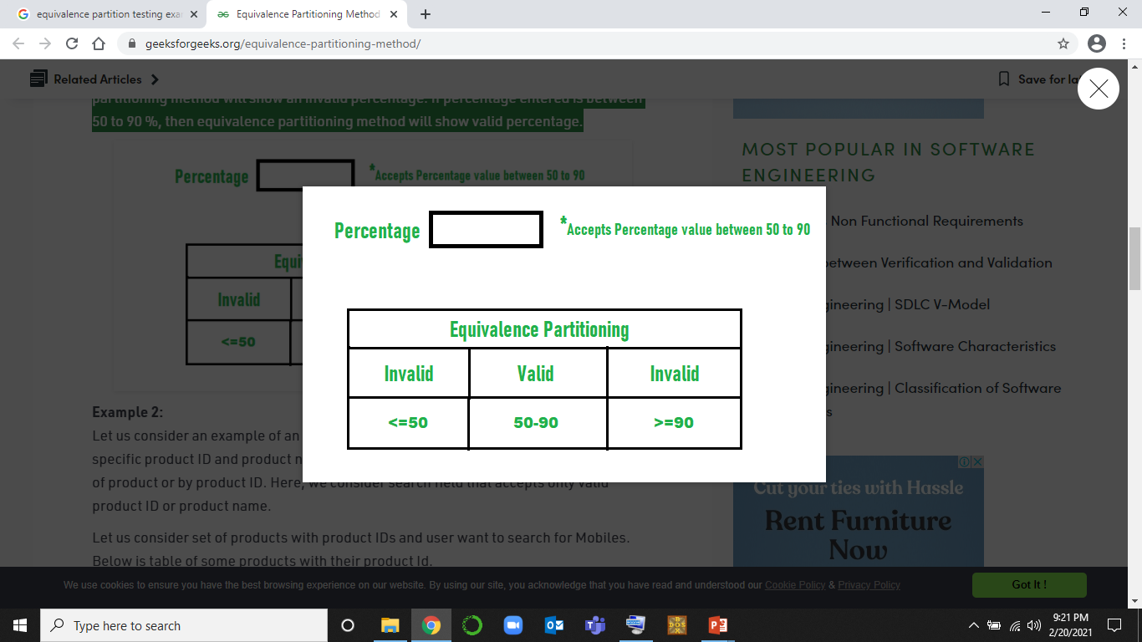
Example-1: Let us consider an example of any college admission process. There is college that gives admissions to students based upon their percentage.
Consider percentage field that will accept percentage only between 50 to 90 %, more and even less than not be accepted, and application will redirect user to error page.
If percentage entered by user is less than 50 %or more than 90 %, that equivalence partitioning method will show an invalid percentage
If percentage entered is between 50 to 90 %, then equivalence partitioning method will show valid percentage.

Slide 31
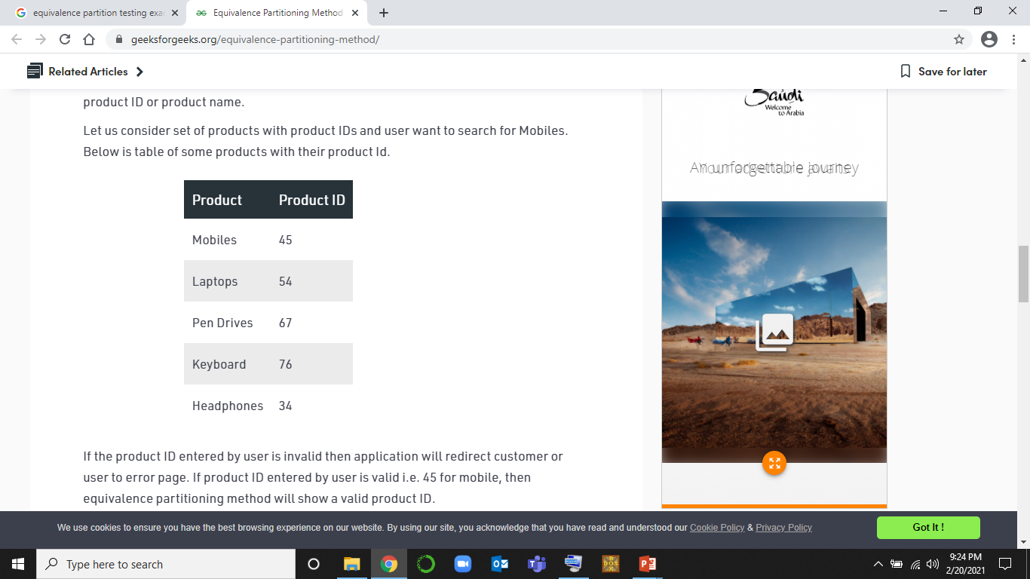
Example 2: Let us consider an example of an online shopping site. In this site, each of products has specific product ID and product name. We can search for product either by using name of product or by product ID. Here, we consider search field that accepts only valid product ID or product name.

Slide 32
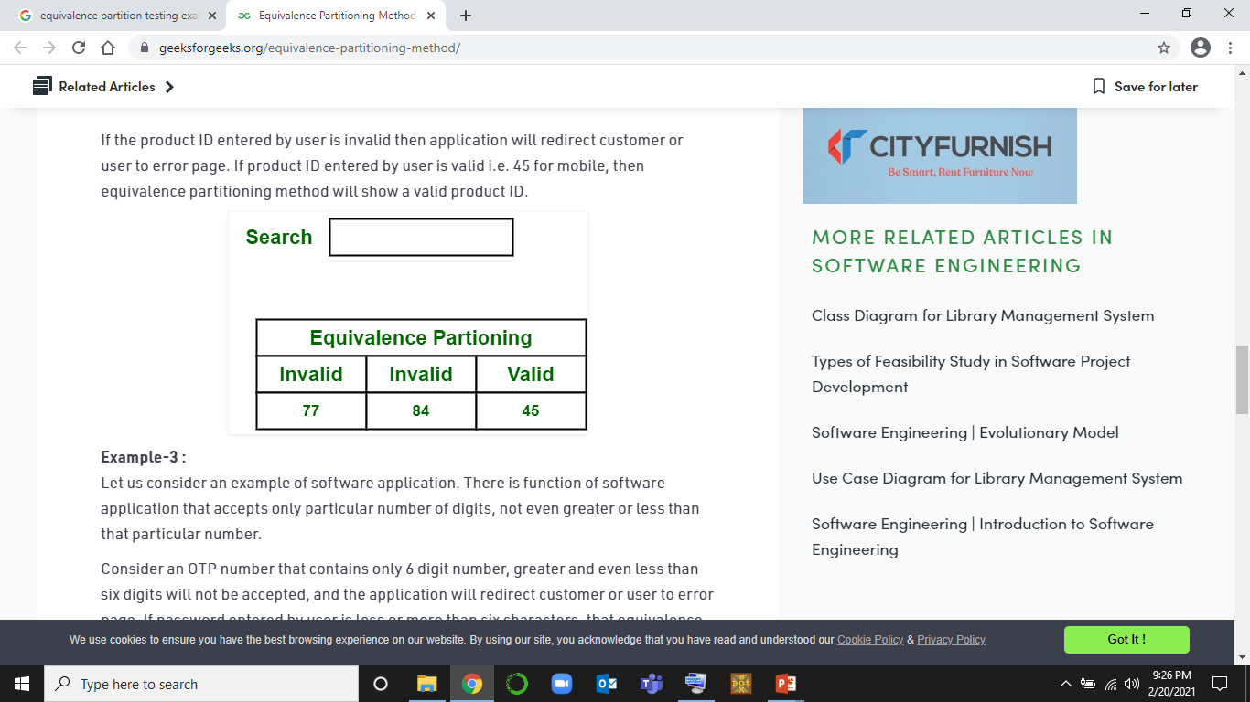

Slide 33
Decision Table
A Decision Table is a tabular representation of inputs versus rules/cases/test conditions. It is a very effective tool used for both complex software testing and requirements management.
Decision table helps to check all possible combinations of conditions for testing and testers can also identify missed conditions easily. The conditions are indicated as True(T) and False(F) values.
What is Decision Table Testing?
Decision table testing is a software testing technique used to test system behavior for different input combinations.
This is a systematic approach where the different input combinations and their corresponding system behavior (Output) are captured in a tabular form.
That is why it is also called as a Cause-Effect table where Cause and effects are captured for better test coverage.

Slide 34
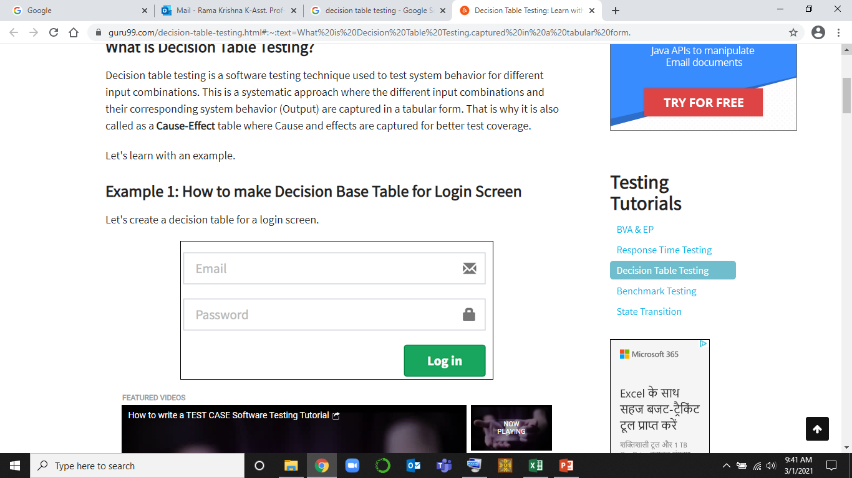
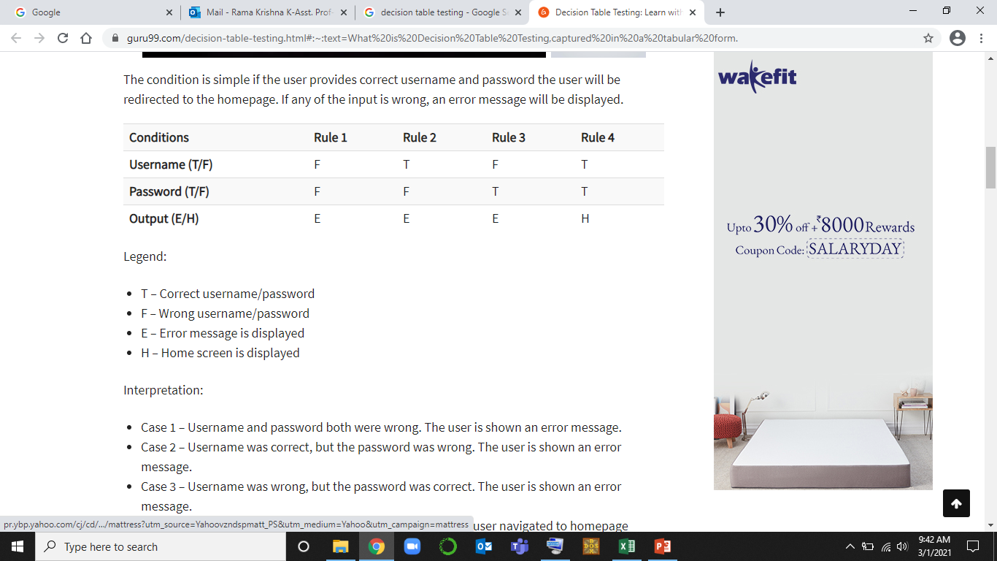

Slide 35
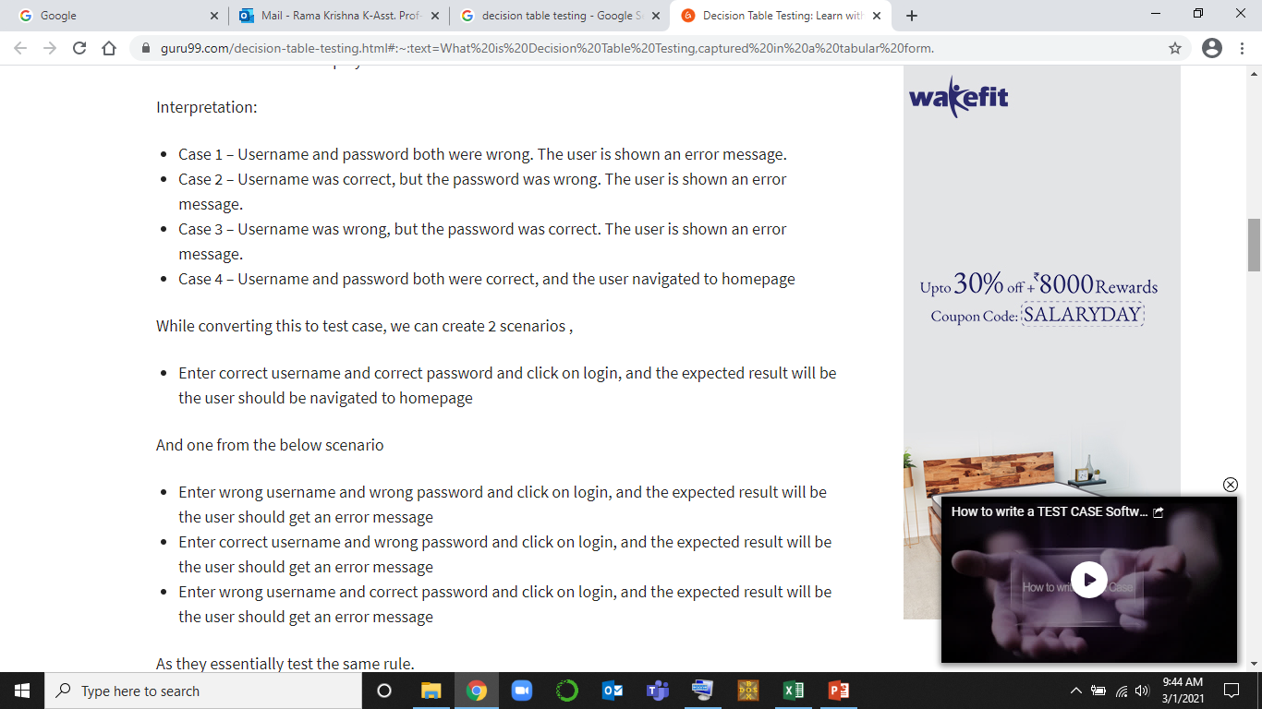

Slide 36
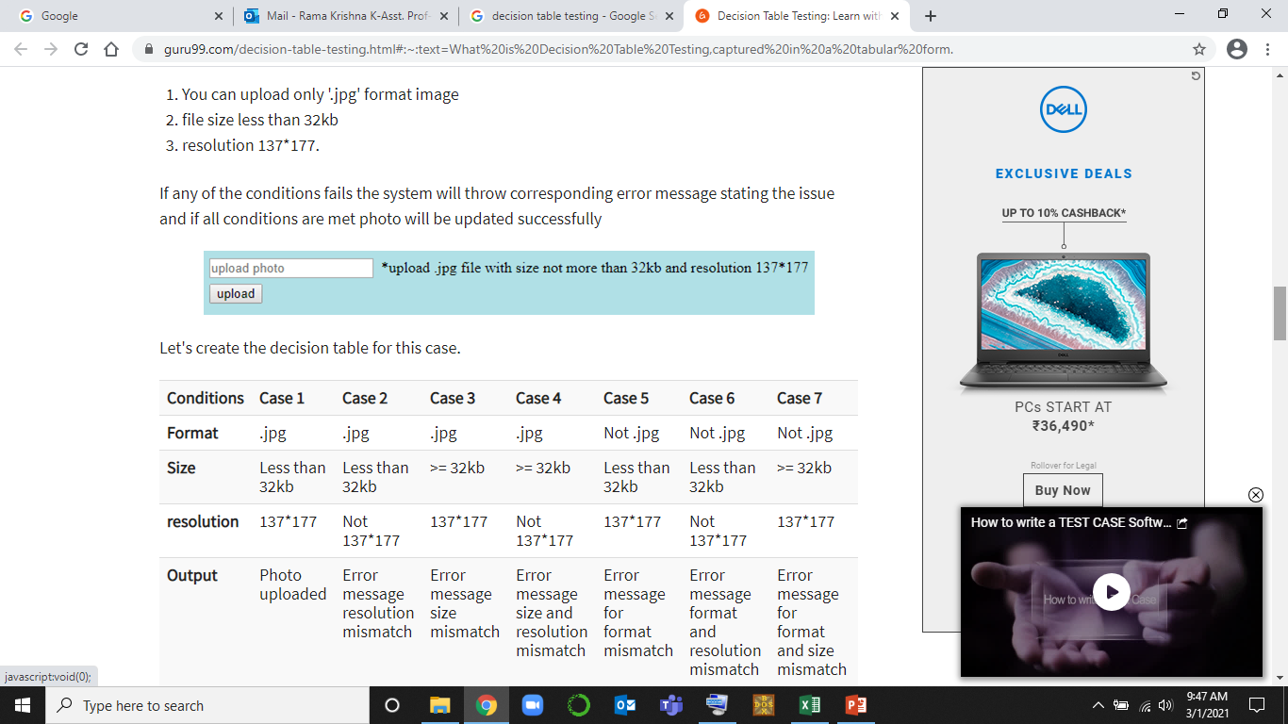
Example 2: How to make Decision Table for Upload Screen Now consider a dialogue box which will ask the user to upload photo with certain conditions like –

Slide 37
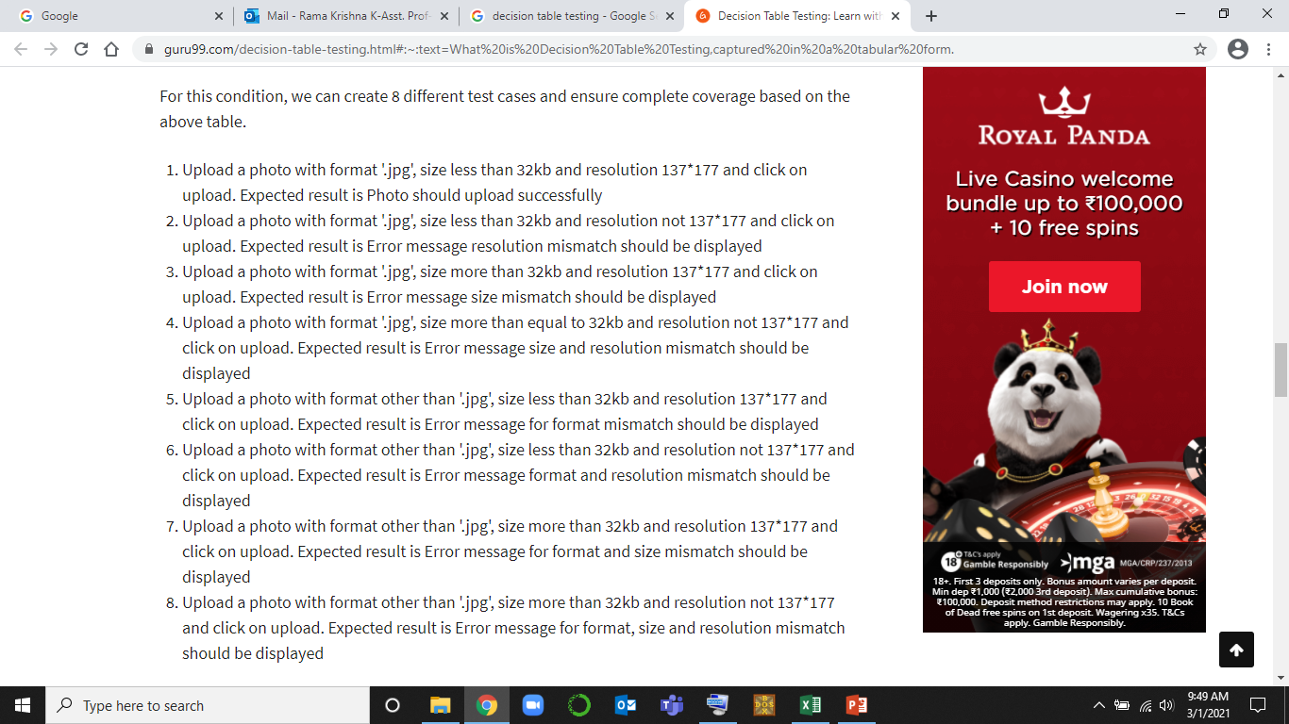

Slide 38
LAB EXERCISES

Slide 39
Exp 1: Design and develop a program in a language of your choice to solve the triangle problem defined as follows: Accept three integers which are supposed to be the three sides of a triangle and determine if the three values represent an equilateral triangle, isosceles triangle, scalene triangle, or they do not form a triangle at all. Assume that the upper limit for the size of any side is 10. Derive test cases for your program based on boundary-value analysis, execute the test cases and discuss the results.
AIM | To derive test cases using Boundary Value Analysis Technique
PROGRAM TO TEST | Triangle Problem
TECHNIQUE USED | Boundary Value Analysis
TYPE OF TESTING | Black Box Testing

Slide 40
TC Id | Test Case Description | Input Data |  |  | Expected Output | Actual Output | Status
 |  | A | b | C
1 | Enter nominal for a & b, min for c | 5 | 5 | 1 | Isosceles
2 | Enter nominal for a & b, min+ for c | 5 | 5 | 2 | Isosceles
3 | Enter nominal for a & b, nominal for c | 5 | 5 | 5 | Equilateral
4 | Enter nominal for a & b, max- for c | 5 | 5 | 9 | Isosceles
5 | Enter nominal for a & b, max for c | 5 | 5 | 10 | Not a Triangle
6 | Enter nominal for a & c, min for b | 5 | 1 | 5 | Isosceles
7 | Enter nominal for a & c, min+ for b | 5 | 2 | 5 | Isosceles
8 | Enter nominal for a & c, max- for b | 5 | 9 | 5 | Isosceles
9 | Enter nominal for a & c, max for b | 5 | 10 | 5 | Not a Triangle
10 | Enter nominal for b & c, min for a | 1 | 5 | 5 | Isosceles
11 | Enter nominal for b & c, min+ for a | 2 | 5 | 5 | Isosceles
12 | Enter nominal for b & c, max- for a | 9 | 5 | 5 | Isosceles
13 | Enter nominal for b & c, max for a | 10 | 5 | 5 | Not a Triangle

Slide 41
TEST REPORT
No of Test Cases Executed:
No of Defects Raised:
No of Test Cases Passed:
No of Test Cases Failed:

Slide 42
Exp 2: Design and develop a program in a language of your choice to solve the triangle problem defined as follows: Accept three integers which are supposed to be the three sides of a triangle and determine if the three values represent an equilateral triangle, isosceles triangle, scalene triangle, or they do not form a triangle at all. Assume that the upper limit for the size of any side is 10. Derive test cases for your program based on equivalence class partitioning, execute the test cases and discuss the results.
AIM | To derive test cases using Equivalence Class Partitioning Technique
PROGRAM TO TEST | Triangle Problem
TECHNIQUE USED | Equivalence Class Partitioning
TYPE OF TESTING | Black Box Testing

Slide 43
Weak Normal and Weak Robust Test case for Triangle Problem
TC Id | Test Case Description | Input Data |  |  | Expected Output | Actual Output | Status
 |  | a | b | c
1 | WN1 | 5 | 5 | 5 | Equilateral
2 | WN2 | 2 | 2 | 3 | Isosceles
3 | WN3 | 3 | 4 | 5 | Scalene
4 | WN4 | 4 | 1 | 2 | Not a Triangle
5 | WR1 | -1 | 5 | 5 | Value of a is not in the range of permitted values
6 | WR2 | 5 | -1 | 5 | Value of b is not in the range of permitted values
7 | WR3 | 5 | 5 | -1 | Value of c is not in the range of permitted values
8 | WR4 | 11 | 5 | 5 | Value of a is not in the range of permitted values
9 | WR5 | 5 | 11 | 5 | Value of b is not in the range of permitted values
10 | WR6 | 5 | 5 | 11 | Value of c is not in the range of permitted values

Slide 44
Strong Robust Test case for Triangle Problem
TC Id | Test Case Description | Input Data |  |  | Expected Output | Actual Output | Status
 |  | a | b | c
1 | SR1 | -1 | 5 | 5 | Value of a is not in the range of permitted values
2 | SR 2 | 5 | -1 | 5 | Value of b is not in the range of permitted values
3 | SR3 | 5 | 5 | -1 | Value of c is not in the range of permitted values
4 | SR4 | -1 | -1 | 5 | Value of a, b is not in the range of permitted values
5 | SR5 | 5 | -1 | -1 | Value of b, c is not in the range of permitted values
6 | SR6 | -1 | 5 | -1 | Value of a, c is not in the range of permitted values
7 | SR7 | -1 | -1 | -1 | Value of a, b, c is not in the range of permitted values

Slide 45
TEST REPORT
No of Test Cases Executed:
No of Defects Raised:
No of Test Cases Passed:
No of Test Cases Failed:

Slide 46
Exp 3: Design and develop a program in a language of your choice to solve the triangle problem defined as follows: Accept three integers which are supposed to be the three sides of a triangle and determine if the three values represent an equilateral triangle, isosceles triangle, scalene triangle, or they do not form a triangle at all. Derive test cases for your program based on decision-table approach, execute the test cases and discuss the results
AIM | To derive test cases using Decision Table Technique
PROGRAM TO TEST | Triangle Problem
TECHNIQUE USED | Decision Table
TYPE OF TESTING | Black Box Testing

Slide 47
DECISION TABLE FOR TRIANGLE PROBLEM
Conditions | Condition Entries (Rules)
 | R 1 | R 2 | R 3 | R 4 | R 5 | R 6 | R 7 | R 8 | R 9 | R 10 | R 11
C1: a<b+c? | F | T | T | T | T | T | T | T | T | T | T
C2: b<a+c? | -- | F | T | T | T | T | T | T | T | T | T
C3: c<a+b? | -- | -- | F | T | T | T | T | T | T | T | T
C4: a=b? | -- | -- | -- | F | T | T | T | F | F | F | T
C5: a=c? | -- | -- | -- | T | F | T | F | T | F | F | T
C6: b=c? | -- | -- | -- | T | T | F | F | F | T | F | T
Actions | Action Entries
a1: Not a Triangle | X | X | X
a2: Scalene |  |  |  |  |  |  |  |  |  | X
a3: Isosceles |  |  |  |  |  |  | X | X | X
a4: Equilateral |  |  |  |  |  |  |  |  |  |  | X
a5: Impossible |  |  |  | X | X | X

Slide 48
Decision table Test Cases for Triangle problem
TC ID | Test Case Description | a | B | c | Expected Output | Actual Output | Status
1 | Testing for Rule 1 | 4 | 1 | 2 | Not a Triangle
2 | Testing for Rule 2 | 1 | 4 | 2 | Not a Triangle
3 | Testing for Rule 3 | 1 | 2 | 4 | Not a Triangle
4 | Testing for Rule 11 | 5 | 5 | 5 | Equilateral
5 | Testing for Rule 7 | 2 | 2 | 3 | Isosceles
6 | Testing for Rule 8 | 2 | 3 | 2 | Isosceles
7 | Testing for Rule 9 | 3 | 2 | 2 | Isosceles
8 | Testing for Rule 10 | 3 | 4 | 5 | Scalene

Slide 49
TEST REPORT
No of Test Cases Executed:
No of Defects Raised:
No of Test Cases Passed:
No of Test Cases Failed:

Slide 50
EXP 4: Design, develop, code and run the program in any suitable language to solve the commission problem. Analyze it from the perspective of boundary value testing, derive different test cases, execute these test cases and discuss the test results.
AIM | To derive test cases using Boundary Value Analysis Technique
PROGRAM TO TEST | Commission Problem
TECHNIQUE USED | Boundary Value Analysis
TYPE OF TESTING | Black Box Testing

Slide 51
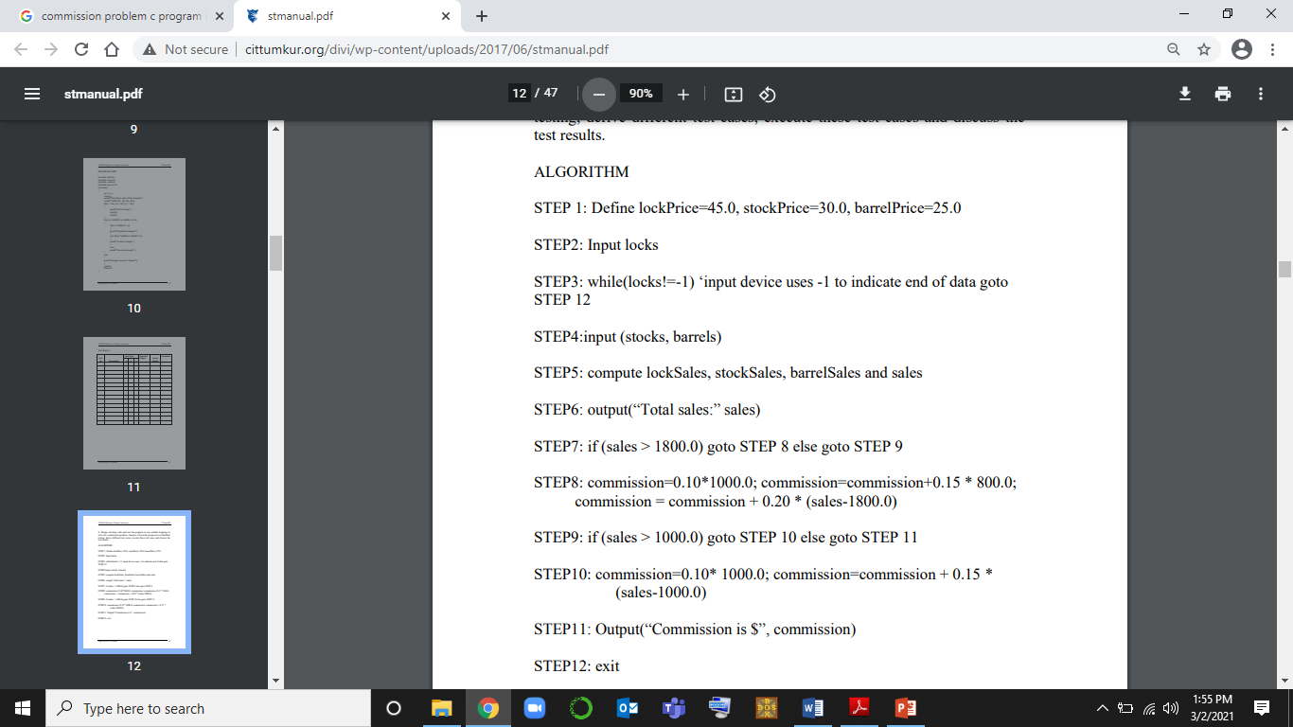

Slide 52
TC Id | Test Case Description | Input Data |  |  | Sales | Expected Output(commission) | Actual Output (sales, commission) | Status
 |  | Locks L | Stocks S | Barrels B
1 | Enter nominal for L, S and min for B | 35 | 40 | 1 | 2800 | 420
2 | Enter nominal for L, S and min + for B | 35 | 40 | 2 | 2825 | 425
3 | Enter nominal for L, S and nominal for B | 35 | 40 | 45 | 3900 | 640
4 | Enter nominal for L, S and max- for B | 35 | 40 | 89 | 5000 | 860
5 | Enter nominal for L, S and max for B | 35 | 40 | 90 | 5025 | 865
6 | Enter nominal for L, B and min for S | 35 | 1 | 45 | 2730 | 406
7 | Enter nominal for L, B and min+ for S | 35 | 2 | 45 | 2760 | 412
8 | Enter nominal for L, B and max- for S | 35 | 79 | 45 | 5070 | 874

Slide 53
9 | Enter nominal for L, B and max for S | 35 | 80 | 45 | 5100 | 880
10 | Enter nominal for B, S and min for L | 1 | 40 | 45 | 2370 | 334
11 | Enter nominal for B, S and min+ for L | 2 | 40 | 45 | 2415 | 343
12 | Enter nominal for B, S and max- for L | 69 | 40 | 45 | 5430 | 946
13 | Enter nominal for B, S and max for L | 70 | 40 | 45 | 5475 | 955

Slide 54
TEST REPORT
No of Test Cases Executed:
No of Defects Raised:
No of Test Cases Passed:
No of Test Cases Failed:

Slide 55
Exp 5:Design, develop, code and run the program in any suitable language to solve the commission problem. Analyze it from the perspective of equivalence class testing, derive different test cases, execute these test cases and discuss the test results.
AIM | To derive test cases using Decision Table Technique
PROGRAM TO TEST | Commission Problem
TECHNIQUE USED | Equivalence Class Partitioning
TYPE OF TESTING | Black Box Testing

Slide 56
EQUIVALENCE CLASS PARTITIONING TEST CASES FOR COMMISSION PROBLEM
TC Id | Test Case Description | Input Data |  |  | Sales | Expected Output(Commission) | Actual Output | Status
 |  | Locks | Stocks | Barrels
1 | WN | 10 | 10 | 10 | $100 | 10
2 | WR2 | -2 | 40 | 45 | Values of locks not in the range 1...70 | Values of locks not in the range 1...70
3 | WR3 | 71 | 40 | 45 | Values of locks not in the range 1...70 | Values of locks not in the range 1...70
4 | WR4 | 35 | -1 | 45 | Values of stocks not in the range 1...80 | Values of stocks not in the range 1...80
5 | WR5 | 35 | 81 | 45 | Values of stocks not in the range 1...80 | Values of stocks not in the range 1...80
6 | WR6 | 35 | 40 | -1 | Values of barrels not in the range 1...90 | Values of barrels not in the range 1...90
7 | WR8 | 35 | 40 | 91 | Values of barrels not in the range 1...90 | Values of barrels not in the range 1...90

Slide 57
TC Id | Test Case Description | Input Data |  |  | Sales | Expected Output(Commission) | Actual Output | Status
 |  | Locks | Stocks | Barrels
1 | SR1 | -2 | 40 | 45 | Values of locks not in the range 1...70 | Values of locks not in the range 1...70
2 | SR2 | 35 | -1 | 45 | Values of stocks not in the range 1...80 | Values of stocks not in the range 1...80
3 | SR3 | 35 | 40 | -2 | Values of barrels not in the range 1...90 | Values of barrels not in the range 1...90
4 | SR4 | -2 | -1 | 45 | Values of locks not in the range 1...70 Values of stocks not in the range 1...80 | Values of locks not in the range 1...70 Values of stocks not in the range 1...80
5 | SR5 | -2 | 40 | -1 | Values of locks not in the range 1...70 Values of barrels not in the range 1...90 | Values of locks not in the range 1...70 Values of barrels not in the range 1...90
6 | SR6 | 35 | -1 | -1 | Values of stocks not in the range 1...80 Values of barrels not in the range 1...90 | Values of stocks not in the range 1...80 Values of barrels not in the range 1...90
7 | SR7 | -2 | -1 | -1 | Values of locks not in the range 1...70 Values of stocks not in the range 1...80 Values of barrels not in the range 1...90 | Values of locks not in the range 1...70 Values of stocks not in the range 1...80 Values of barrels not in the range 1...90

Slide 58
TEST REPORT
No of Test Cases Executed:
No of Defects Raised:
No of Test Cases Passed:
No of Test Cases Failed:

Slide 59
Exp 6:Design, develop, code and run the program in any suitable language to solve the commission problem. Analyze it from the perspective of Decision table testing, derive different test cases, execute these test cases and discuss the test results.
AIM | To derive test cases using Decision Table Technique
PROGRAM TO TEST | Commission Problem
TECHNIQUE USED | Decision Table
TYPE OF TESTING | Black Box Testing

Slide 60
Decision Table for Commission Problem
Conditions | Condition Entries (Rules)
C1: 1≤locks≤70? | F | T | T | T | T | T | T
C2: 1≤stocks≤80? | -- | F | T | T | T | T | T
C3: 1≤barrels≤90? | -- | -- | F | F | T | T | T
C4: sales>1800? | -- | -- | -- | -- | T | F | F
C5: sales>1000? | -- | -- | -- | -- | -- | T | F
C6: sales≤1000? | -- | -- | -- | -- | -- | -- | T
Actions | Action Entries
a1: com1 = 0.10*Sales |  |  |  |  |  |  | X
a2: com2 = com1+0.15*(sales-1000) |  |  |  |  |  | X
a3: com3 = com2+0.20*(sales-1800) |  |  |  |  | X
a4: Invalid Locks input | X
a4: Invalid Stocks input |  | X
a4: Invalid Barrels input |  |  | X

Slide 61
Decision Table Test Cases
TC ID | Test Case Description | Locks | Stocks | Barrels | Expected Output | Actual Output | Status
1 | Enter Invalid for locks and valid for stocks and barrels | -2 | 40 | 45 | Value of locks not in the range 1..70
2 | Enter Invalid for locks and valid for stocks and barrels | 90 | 40 | 45 | Value of locks not in the range 1..70
3 | Enter Invalid for stocks and valid for locks and barrels | 35 | -3 | 45 | Value of stocks not in the range 1..80
4 | Enter Invalid for stocks and valid for locks and barrels | 35 | 100 | 45 | Value of stocks not in the range 1..80

Slide 62
Decision Table Test Cases
5 | Enter Invalid for barrels and valid for locks and stocks | 35 | 40 | -10 | Value of barrels not in the range 1..80
6 | Enter Invalid for barrels and valid for locks and stocks | 35 | 40 | 150 | Value of barrels not in the range 1..80
7 | Enter inputs where sales <1000 | 5 | 5 | 5 | Sales:500 | a1:50
8 | Enter inputs where sales >1000 | 15 | 15 | 15 | Sales:1500 | a2: 175
9 | Enter inputs where sales >1800 | 25 | 25 | 25 | Sales:2500 | a3: 360

Slide 63
EXERCISE-3
Problem Definition:
"Next Date" is a function consisting of three variables like: month, date and year. It returns the date of next day as output. It reads current date as input date. The constraints are
C1: 1 ≤ month ≤ 12 C2: 1 ≤ day ≤ 31 C3: 1812 ≤ year ≤ 2020.
If any one condition out of C1, C2 or C3 fails, then this function produces an output "value of month not in the range 1...12".
Since many combinations of dates can exist, hence we can simply display one message for this function: "Invalid Input Date".
A very common and popular problem occurs if the year is a leap year. We have taken into consideration that there are 31 days in a month. But what happens if a month has 30 days or even 29 or 28 days?
A year is called as a leap year if it is divisible by 4.

Slide 64
#include<stdio.h>
#include<ctype.h>
int check(int day,int month)
{
if((month==4||month==6||month==9 ||month==11) && day==31)
return 1;
else
return 0;
}
int isleap(int year)
{
if (year % 400 == 0 || (year % 100 != 0 && year % 4 == 0))
return 1;
else
return 0;
}

Slide 65
int main()
{
int day, month, year, tomm_day, tomm_month, tomm_year;
char flag;
do
{
flag='y';
printf("\n Enter the today's date in the form of dd mm yyyy \n");
scanf("%d%d%d",&day,&month,&year);
tomm_month=month;
tomm_year= year;
if(day<1 || day>31)
{
printf("value of day, not in the range 1...31\n");
flag='n';
}
if(month<1 || month>12)
{
printf("value of month, not in the range 1....12\n");
flag='n'; }

Slide 66
else if(check (day,month))
{
printf("value of day, not in the range day<=30");
flag='n';
}
if(year<=1812 || year>2020)
{
printf("value of year, not in the range 1812.......2020\n");
flag='n';
}
if(month==2)
{
if(isleap(year) && day>29)
{
printf("invalid date input for leap year");
flag='n';
}

Slide 67
else if(!(isleap(year))&& day>28)
{
printf("invalid date input for not a leap year");
flag='n';
}
}
}
}
while(flag=='n');

Slide 68
switch (month)
{
case 1:
case 3:
case 5:
case 7:
case 8:
case 10:if(day<31)
tomm_day=day+1;
else
{
tomm_day=1;
tomm_month=month+1;
}
break;

Slide 69
case 4:
case 6:
case 9:
case 11: if(day<30)
tomm_day=day+1;
else
{
tomm_day=1;
tomm_month=month+1;
}
break;

Slide 70
case 12: if(day<31)
tomm_day=day+1;
else
{
tomm_day=1;
tomm_month=1;
if(year==2020)
{
printf("the next day is out of boundary value of year\n");
return 0;
}
else
tomm_year=year+1;
}
break;

Slide 71
case 2:
if(day<28)
tomm_day= day+1;
else if(isleap(year) && day==28)
tomm_day=day+1;
else if(day==28 || day==29)
{
tomm_day=1;
tomm_month=3;
}
break;
}
printf("next day is : %d %d %d",tomm_day, tomm_month, tomm_year);
return 0;
}

Slide 72
BOUNDARY VALUE TESTING
The constraints are
C1: 1 ≤ month ≤ 12
C2: 1 ≤ day ≤ 31
C3: 1900 ≤ year ≤ 2024
The Next Date program takes date as input and checks it for validity. If it is valid, it returns the next date as its output.
Here we have three inputs for the program, hence n = 3.
Since BVA yields (4n + 1) test cases according to single fault assumption theory,
hence we can say that the total number of test cases will be (4*3+1)=12+1=13.
The boundary value test cases are
C1: 1 ≤ month ≤ 12
C2: 1 ≤ day ≤ 31
C3: 1900 ≤ year ≤ 2024

Slide 73
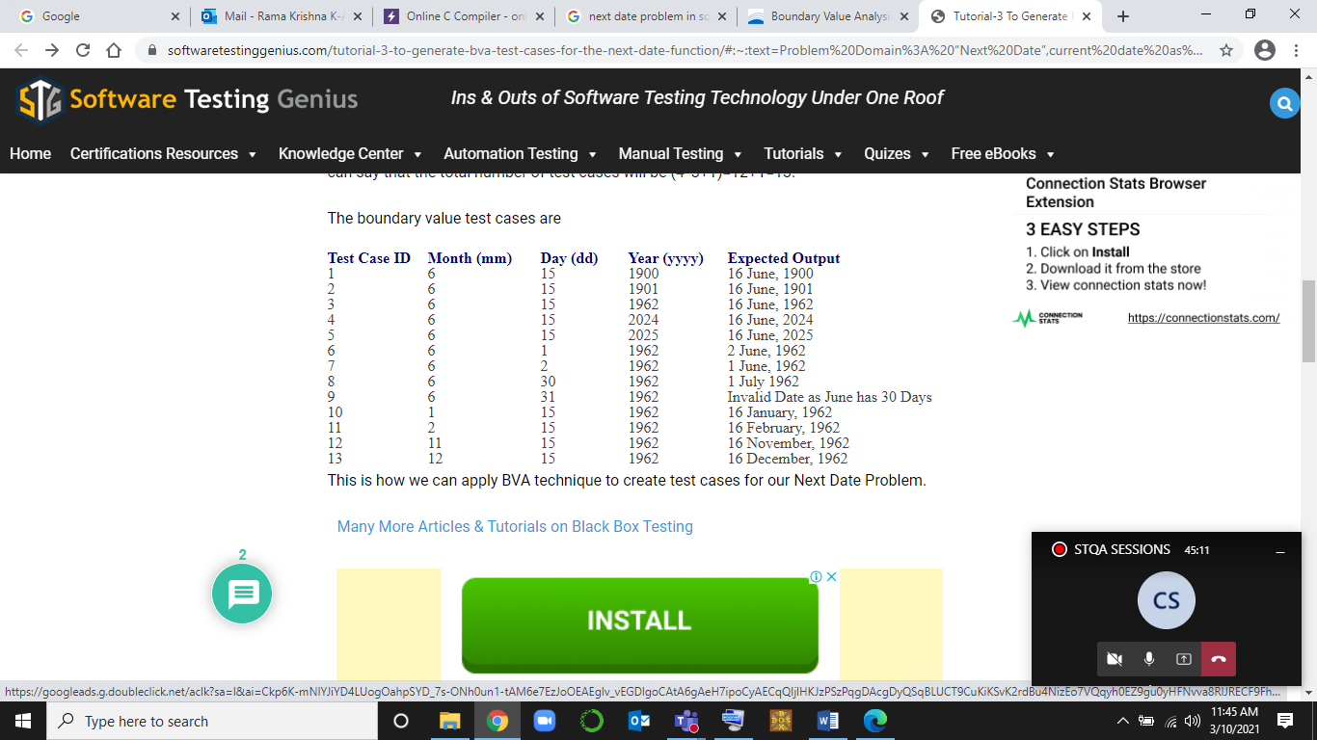

Slide 74
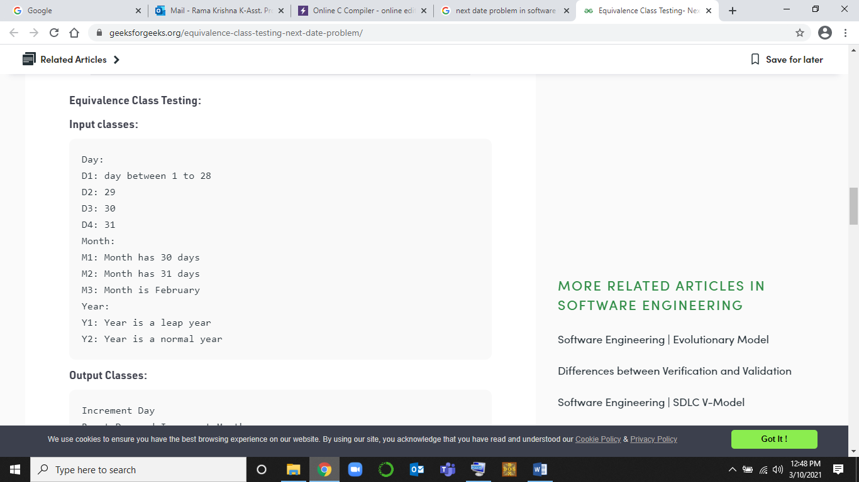

Slide 75
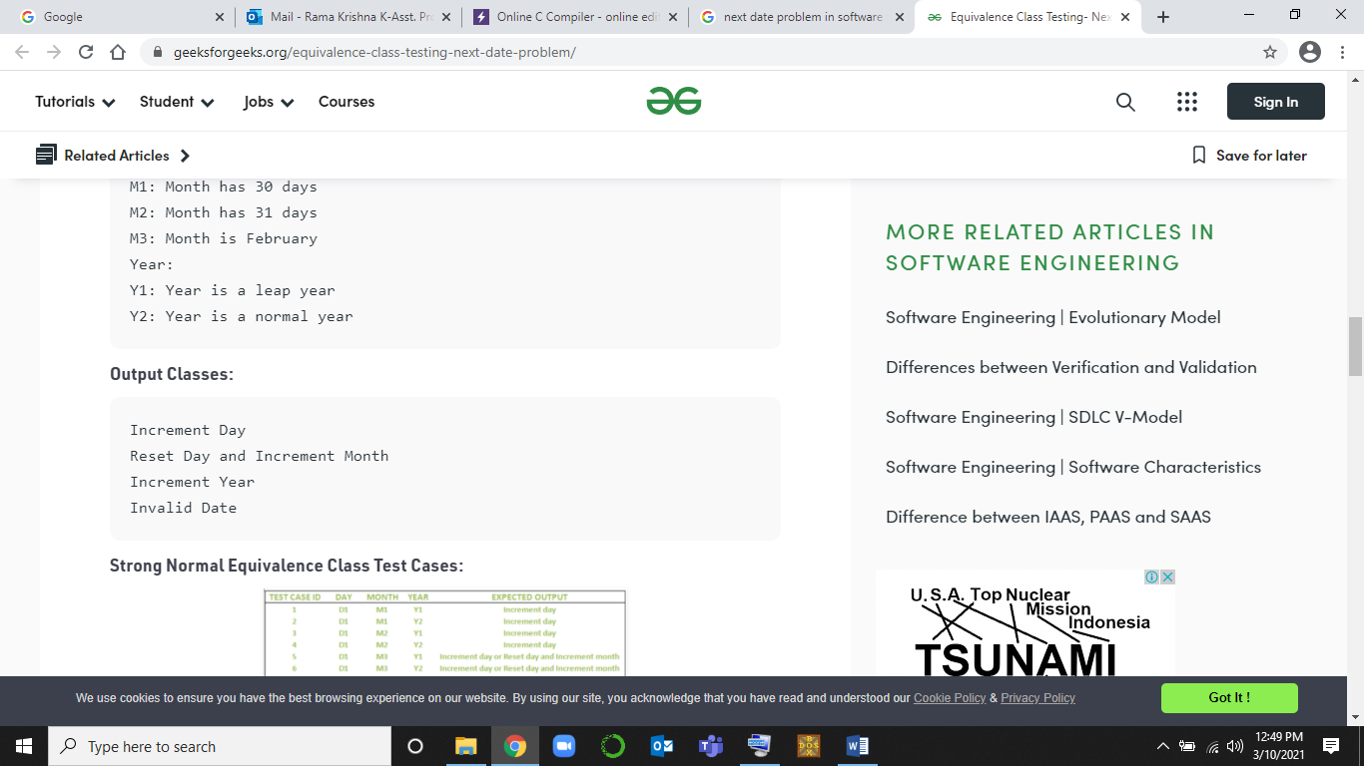

Slide 76
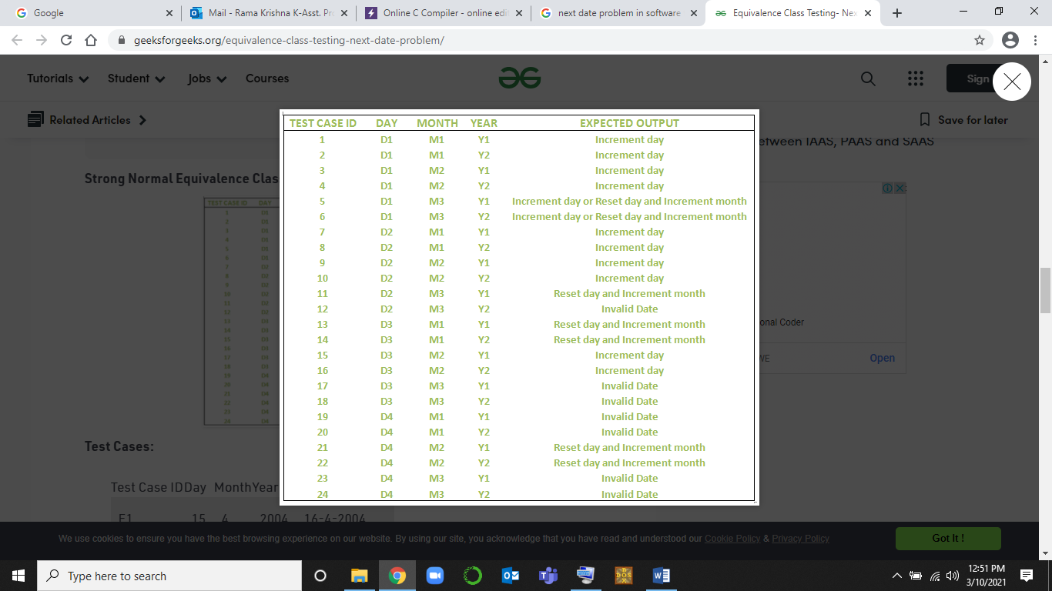
STRONG NORMAL EQUIVALENCE TEST CLASS

Slide 77
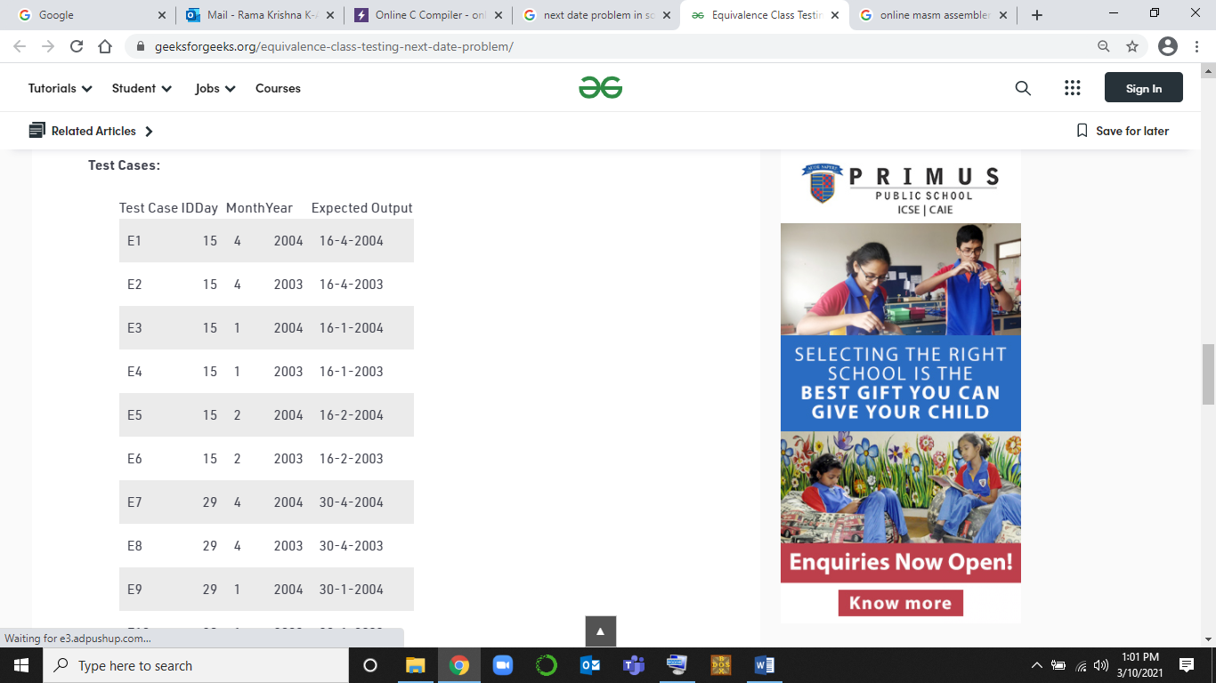

Slide 78
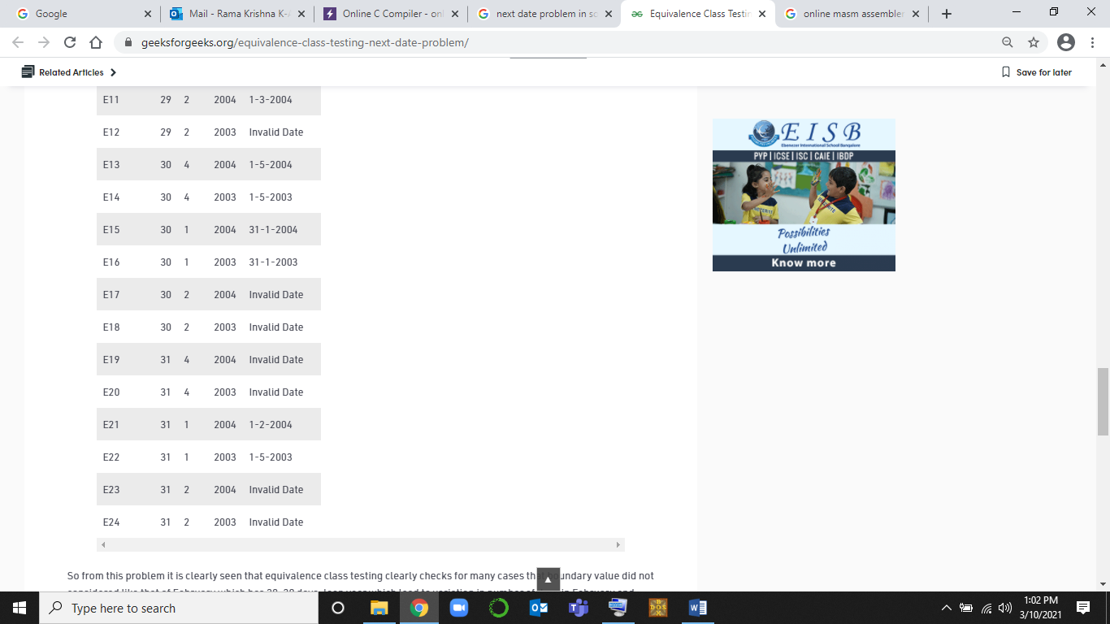

Slide 79
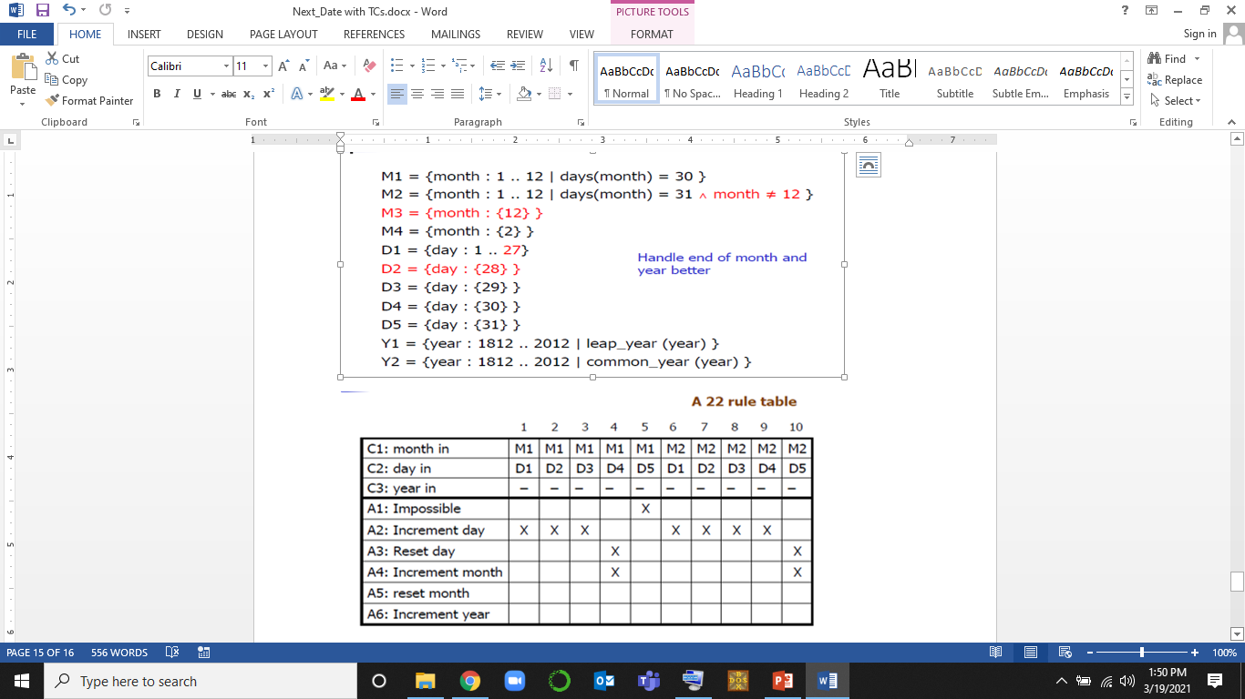
Decision Table for Nextdate problem

Slide 80
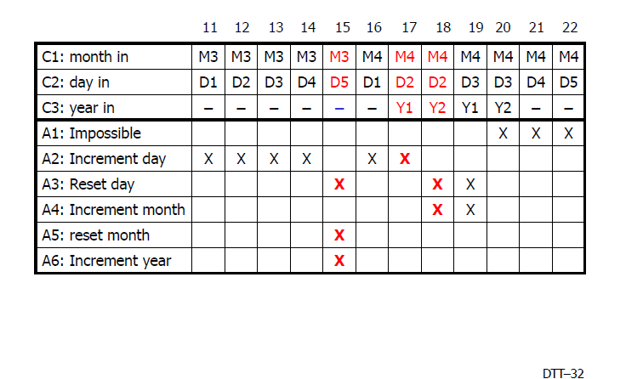

Slide 81
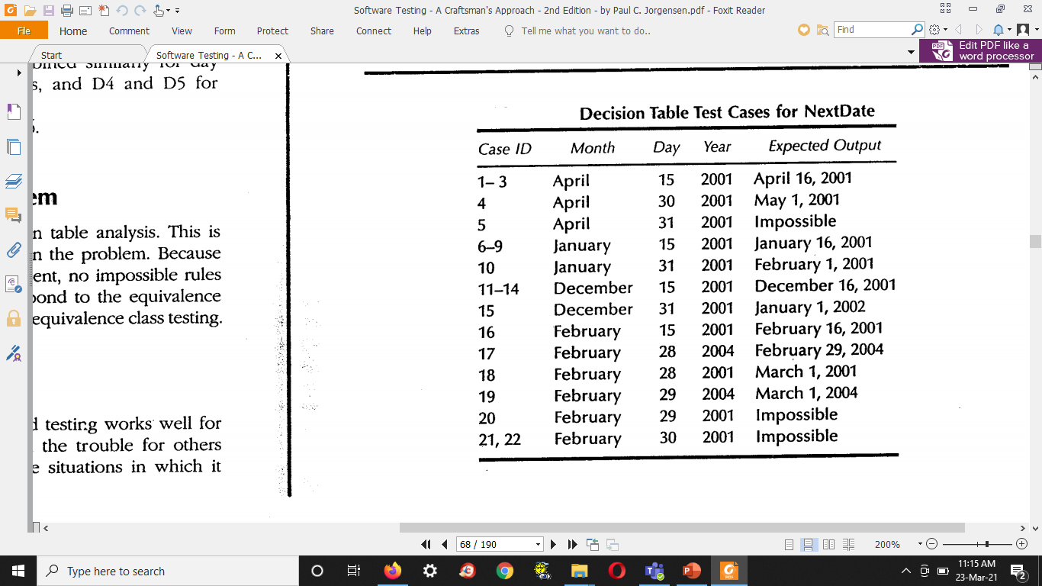
DECISION TABLE TEST CASES

Slide 82
LAB EXERCISES ON WHITE BOX TESTING

Slide 83
Introduction to White box testing
It is a testing method in which the internal structure/design/implementation of the program is being tested.
Also known as Clear Box Testing, Open Box Testing, Glass Box Testing, Transparent Box Testing, Code-Based Testing or Structural Testing)
The tester chooses inputs to exercise paths through the code and determines the appropriate outputs.
The key principles that assist you in executing white box tests successfully are:
Statement Coverage – ensure every single line of code is tested.
Branch Coverage – ensure every branch (e.g. true or false) is tested.
Path Coverage – ensure all possible paths are tested.

Slide 84
Advantages of White Box Testing:
Forces test developer to reason carefully about implementation.
Reveals errors in "hidden" code.
Spots the Dead Code or other issues with respect to best programming practices.

Slide 85
Disadvantages of White Box Testing:
Expensive as one has to spend both time and money to perform white box testing.
Every possibility that few lines of code are missed accidentally.
In-depth knowledge about the programming language is necessary to perform white box testing.

Slide 86
Levels applicable to:
White Box Testing method is applicable to the following levels of software testing:
Unit Testing: For testing paths within a unit.
Integration Testing: For testing paths between units.
System Testing: For testing paths between subsystems.

Slide 87
Static Testing
Static testing is a software testing method that involves examination of the program's code and its associated documentation but does not require the program be executed.
Static Testing, a software testing technique in which the software is tested without executing the code. It has two parts as listed below:
Review - Typically used to find and eliminate errors or ambiguities in documents such as requirements, design, test cases, etc.
Static analysis - The code written by developers are analyzed (usually by tools) for structural defects that may lead to defects.

Slide 88
Static Testing is defined as a software testing technique by which we can check the defects in software without actually executing it. Its counter-part is Dynamic Testing which checks an application when the code is run
The two main types of static testing techniques are
Manual examinations: Manual examinations include analysis of code done manually, also known as REVIEWS.
Automated analysis using tools: Automated analysis are basically static analysis which is done using tools.

Slide 89
Static Testing by humans
There are multiples ways to achieve Static testing by humans. Few of them are as follows:
Desk checking of the code
Code walkthrough
Code Review
Code Inspection

Slide 90
Desk checking of the code
Desk checking is an informal manual test that programmers can use to verify coding and algorithm logic before a program launch. This enables them to spot errors that might prevent a program from working as it should.
Desk checking is a similar process to proof reading; in this exercise, the programmer runs through lines of code to identify errors and to check logic.
Typically, the programmer will print out the code and go through it in a pencil and paper exercise. This usually involves creating a table with columns containing line numbers, variables, conditions, and inputs and outputs, depending on the checks he is making.

Slide 91
Code walkthrough
Code Walkthrough is a form of peer review in which a programmer leads the review process and the other team members ask questions and spot possible errors against development standards and other issues.
The meeting is usually led by the author of the document under review and attended by other members of the team.
The main purpose of walkthrough is to enable learning about the content of the document under review to help team members gain an understanding of the content of the document and also to find defects.

Slide 92
Code Review
Code review (sometimes referred to as peer review) is a software quality assurance activity in which one or several humans check a program mainly by viewing and reading parts of its source code, and they do so after implementation or as an interruption of implementation.
Code review is systematic examination (often as peer review) of computer source code. It is intended to find and fix mistakes overlooked in the initial development phase, improving both the overall quality of software and the developers' skills.

Slide 93
Code Inspection
Code Inspection is the most formal type of review, which is a kind of static testing to avoid the defect multiplication at a later stage. The main purpose of code inspection is to find defects and it can also spot any process improvement if any.
The inspection process is the most formal type of review based on rules and checklists and makes use of entry and exit criteria.
It usually involves peer examination of the code and each one has a defined set of roles.
After the meeting, a formal follow-up process is used to ensure that corrective action is completed in a timely manner.

Slide 94
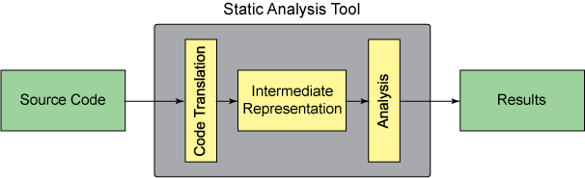
Static Testing by Tools
Static analysis tools are generally used by developers as part of the development and component testing process.
The key aspect is that the code (or other artefact) is not executed or run but the tool itself is executed, and the source code we are interested in is the input data to the tool.

Slide 95
Other than software code, static analysis can also be carried out on things like, static analysis of requirements or static analysis of websites (for example, to assess for proper use of accessibility tags or the following of HTML standards).
Static analysis tools for code can help the developers to understand the structure of the code, and can also be used to enforce coding standards.
Features or characteristics of static analysis tools are:
To calculate metrics such as cyclomatic complexity or nesting levels (which can help to identify where more testing may be needed due to increased risk).
To enforce coding standards.
To analyze structures and dependencies.
Help in code understanding.
To identify anomalies or defects in the code.

Slide 96
Exp 9: Design, develop, code and run the program in any suitable language to implement the binary search algorithm. Determine the basis paths and using them derive different test cases, execute these test cases and discuss the test results.
AIM | To derive test cases using Boundary Value Analysis Technique
PROGRAM TO TEST | Binary Search
TECHNIQUE USED | Basis paths testing
TYPE OF TESTING | White Box Testing

Slide 97
What is Path Testing?
Path testing is a structural testing method that involves using the source code of a program in order to find every possible executable path. It helps to determine all faults lying within a piece of code. This method is designed to execute all or selected path through a computer program.

Slide 98
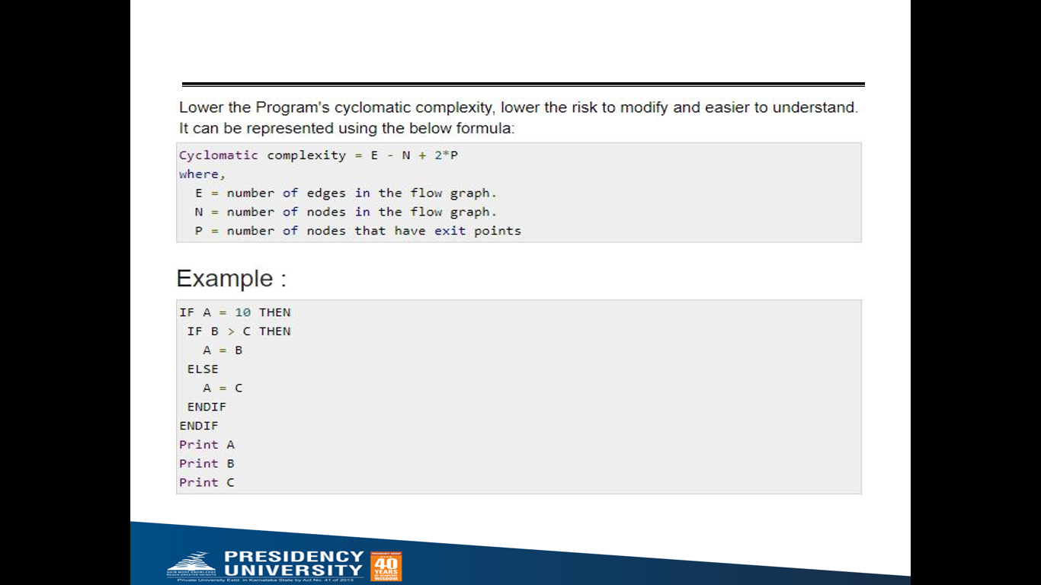
Basis Path Testing
Basis path testing is a form of Structural testing (White Box testing). The method devised by McCabe to carry out basis path testing has four steps. These are:
1. Draw the program graph.
2. Calculate the cyclomatic complexity.
3. Select a basis set of paths.
4. Generate test cases for each of these paths
Cyclomatic complexity is a source code complexity measurement that is being correlated to a number of coding errors. It is calculated by developing a Control Flow Graph of the code that measures the number of linearly-independent paths through a program module.

Slide 99
Lab Exercise Complete Binary Search program
int binsrc(int x[],int low, int high, int key)
{
int mid; 1
while(low<=high) 2
{
mid=(low+high)/2;
if(x[mid]==key) 3
return mid; 8
if(x[mid]<key) 4
low=mid+1; 5
else
high=mid-1; 6
} 7
return -1; 8
} 9

Slide 100
int main()
{
int a[20],key,i,n,succ;
printf("Enter the n value");
scanf("%d",&n);
if(n>0)
{
printf("enter the elements in ascending order\n");
for(i=0;i<n;i++)
scanf("%d",&a[i]);
printf("enter the key element to be searched\n");
scanf("%d",&key);
succ=binsrc(a,0,n-1,key);
if(succ>=0)
printf("Element found in position = %d\n",succ+1);
else
printf("Element not found \n");
}
else
printf("Number of element should be greater than zero\n");
return 0;
}

Slide 101
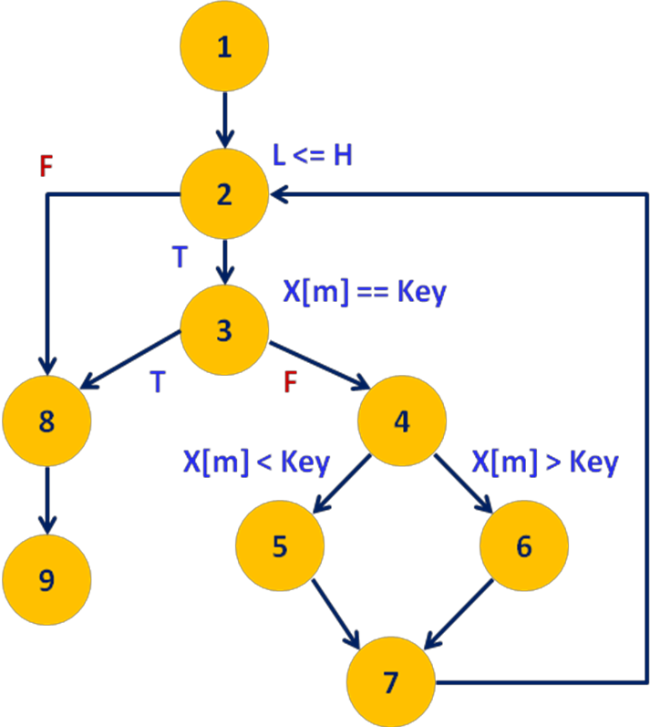
#include<stdio.h>
int binsrc(int x[],int low, int high, int key)
{
int mid; 1
while(low<=high) 2
{
mid=(low+high)/2;
if(x[mid]==key) 3
return mid; 8
if(x[mid]<key) 4
low=mid+1; 5
else
high=mid-1; 6
} 7
return -1; 8
} 9
PROGRAM GRAPH

Slide 102
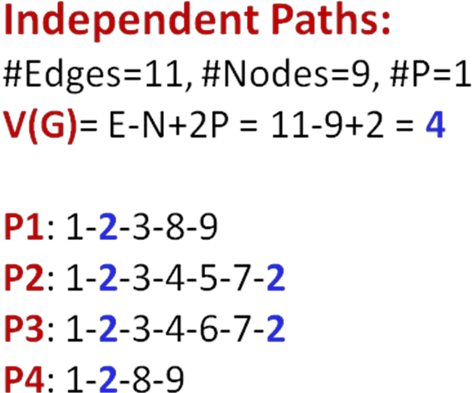
_{BASIS PATHS}

Slide 103
DERIVING TEST CASES USING BASIS PATH TESTING The last step is to devise test cases for the basis paths. TEST CASES
TC ID | PATHS | array elements | key | Expected Output | Actual Output | Status
1 | 1-2-3-8-9 | {10.20.30.40.50} | 30 | Element found in position = 3
2 | 1-2-3-4-5-7-2 | {10.20.30.40.50} | 20 | Element found in position = 2
3 | 1-2-3-4-6-7-2 | {10.20.30.40.50} | 40 | Element found in position = 4
4 | 1-2-8-9 | NA | NA | NA | NA | NA

Slide 104
Exp 5: Design, develop, code and run the program in any suitable language to implement an absolute letter grading procedure, making suitable assumptions. Determine the basis paths and using them derive different test cases, execute these test cases and discuss the test results.
AIM | WRITE CODE AND TEST CASES, EXECUTE TEST CASES
PROGRAM TO TEST | Letter grading procedure
TECHNIQUE USED | Basis paths testing
TYPE OF TESTING | White Box Testing

Slide 105
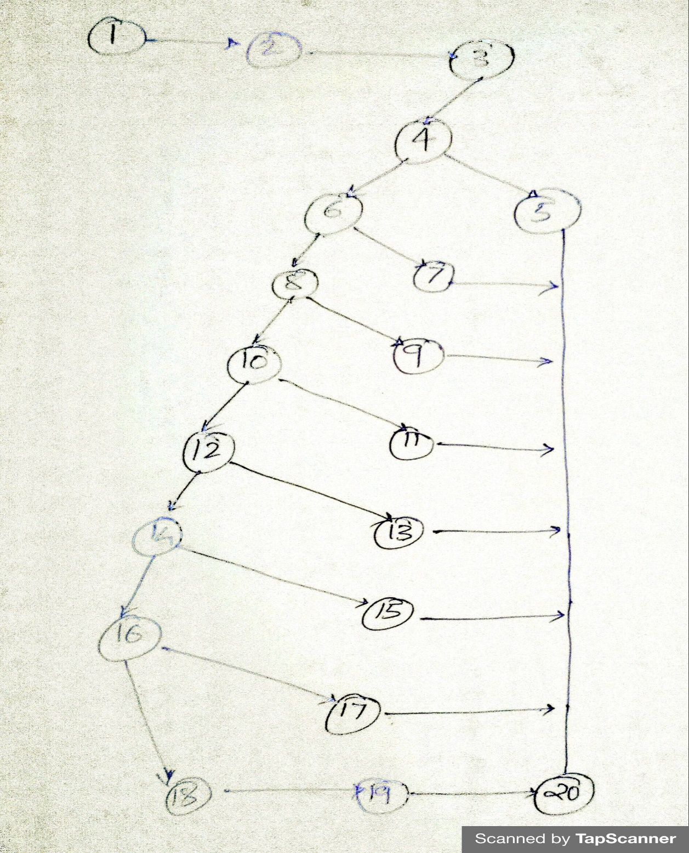
#include<stdio.h>
main()
{
int per;
printf("Enter percentage\n");
scanf("%d",&per);
if((per<35)&&(per>=1))
printf("fail");
else if((per<=40)&&(per>=35))
printf("Grade C");
else if((per<=50)&&(per>40))
printf("Grade C+");
else if((per<=60)&&(per>50))
printf("Grade B");
else if((per<=70)&&(per>60))
printf("Grade B+");
else if((per<=80)&&(per>70))
printf("Grade A");
else if((per<=100)&&(per>80))
printf("Grade A+");
else
printf("Invalid input\n");
}

Slide 106
Calculate the cyclomatic complexity.
V(G)= E – N + 2 * P =
Basis Paths:

Slide 107
BASIS PATHS TEST CASES

Slide 108
Design, develop, code and run the program in any suitable language to implement a PRIME NUMBER CHECKING procedure, making suitable assumptions. Determine the basis paths and using them derive different test cases, execute these test cases and discuss the test results.
int main (){
int n, index;
cout << "Enter a number: " <> n;
index = 2;
while (index <= n - 1){
if (n % index == 0){
cout << "It is not a prime number" << endl;
break;
}
index++;
}
if (index == n)
cout << "It is a prime number" << endl;
} // end main

Slide 109
#include <stdio.h>
int main() {
int n, i, flag = 0;
printf("Enter a positive integer: ");
scanf("%d", &n);
// 0 and 1 are not prime numbers
// change flag to 1 for non-prime number
if (n == 0 || n == 1)
flag = 1;
for (i = 2; i <= n / 2; ++i) {
// if n is divisible by i, then n is not prime
// change flag to 1 for non-prime number
if (n % i == 0) {
flag = 1;
break; } }
// flag is 0 for prime numbers
if (flag == 0)
printf("%d is a prime number.", n);
else
printf("%d is not a prime number.", n);
return 0; }

Slide 110
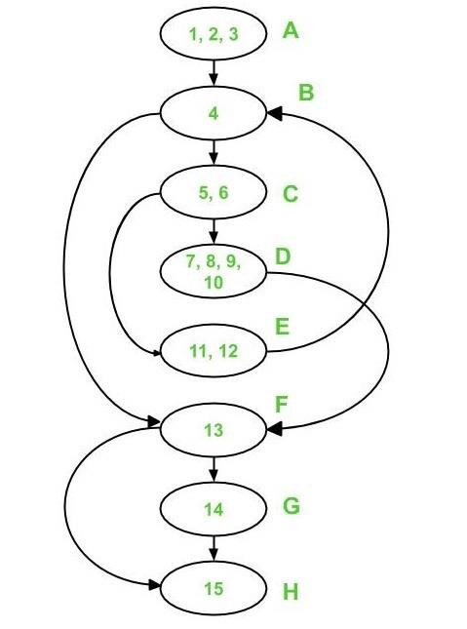

Slide 111
Calculate the cyclomatic complexity by using the following formula −
V(G) = e - n + 2*p
In the control flow diagram above,
where e = 10, n = 8, and p =1
As a result, V(G) = 10 - 8 + 2 * 1 = 4 Cyclomatic Complexity

Slide 112
BASIS PATHS
A – B – F – G – H is the first path.
A – B – F – H is the second path.
A - B - C - E - B - F - G - H is the third path
A - B - C - D - F - H is the fourth path.

Slide 113
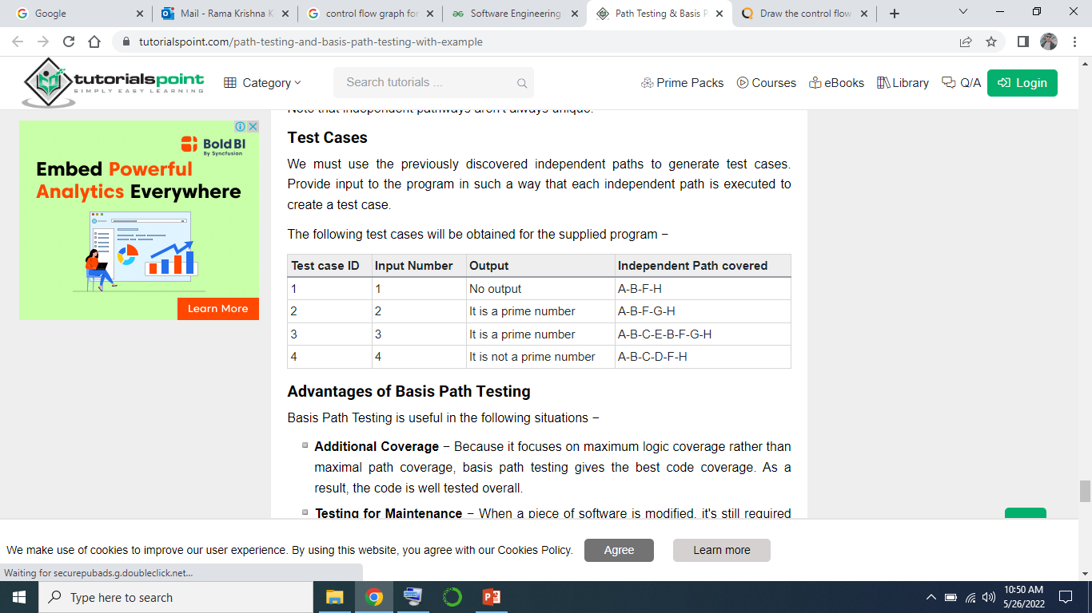
BASIS PATH TEST CASES

